Slide 1

Air Quality Paris vs. Lyon
Final Project – Data Analytics Bootcamp
Radoslaw Debek
Paris, 11.02.2022

Slide 2
01
02
…
…
INTRODUCTION / PIPLINE
Stages of the project
TIME SERIES
Forecast of Air Pollution for 2022
03
04
…
…
SUPERVISED ML
Air Quality from Weather
CONCLUSIONS
Main Findings

Slide 3
01
…
INTRODUCTION / PIPLINE
Stages of the project
GOAL:
Analyse and compare historical data of air pollution and weather in two cities (Paris & Lyon):
Forecast air pollution for 2022 (Time Series)
Predict air quality on a given day using only weather information (Supervised ML)

Slide 4







01
…
INTRODUCTION / PIPLINE
Stages of the project
Air Pollution
Weather
Paris
Lyon
Prophet
Forecast for 2022
Analysis of historical data,
results
● Data Collection
● Data Selection
● Time Series
● Data Analysis
● Data Loading
● Data Cleaning
● Machine Learning
● Dashboard
MySQL
Missing values
Outliers
Repeated information
Balanced Random Forest
Prediction of air quality
Streamlit

Slide 5

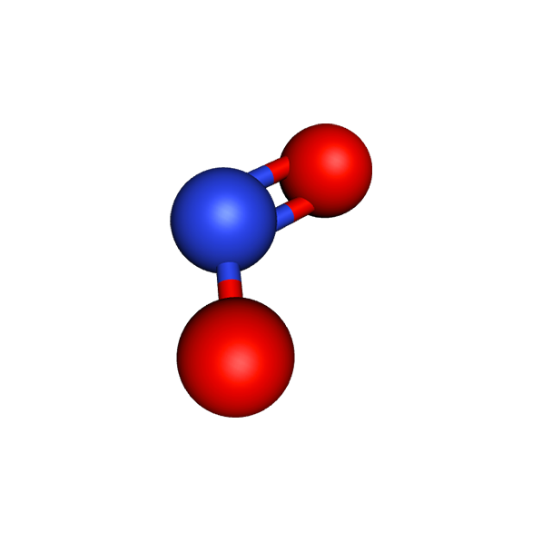
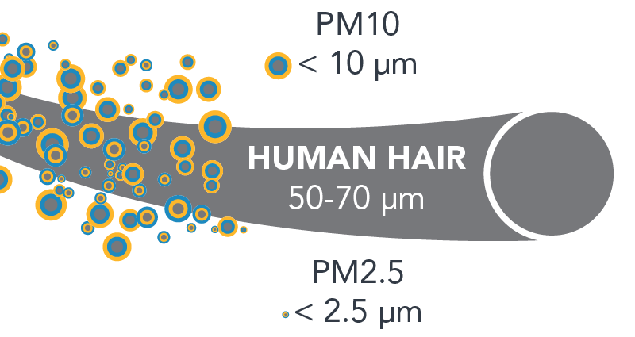

02
…
TIME SERIES
Forecast of Air Pollution for 2022
Stationarity test
Autocorrelation check
Train/test model
Prophet model
Error RMSE
Forecasting for 2022
Analysed period: 2014-2021
Analysed pollutants:
PARTICULATE MATTER: PM2.5 and PM10
OZONE
NITROGEN DIOXIDE

Slide 6
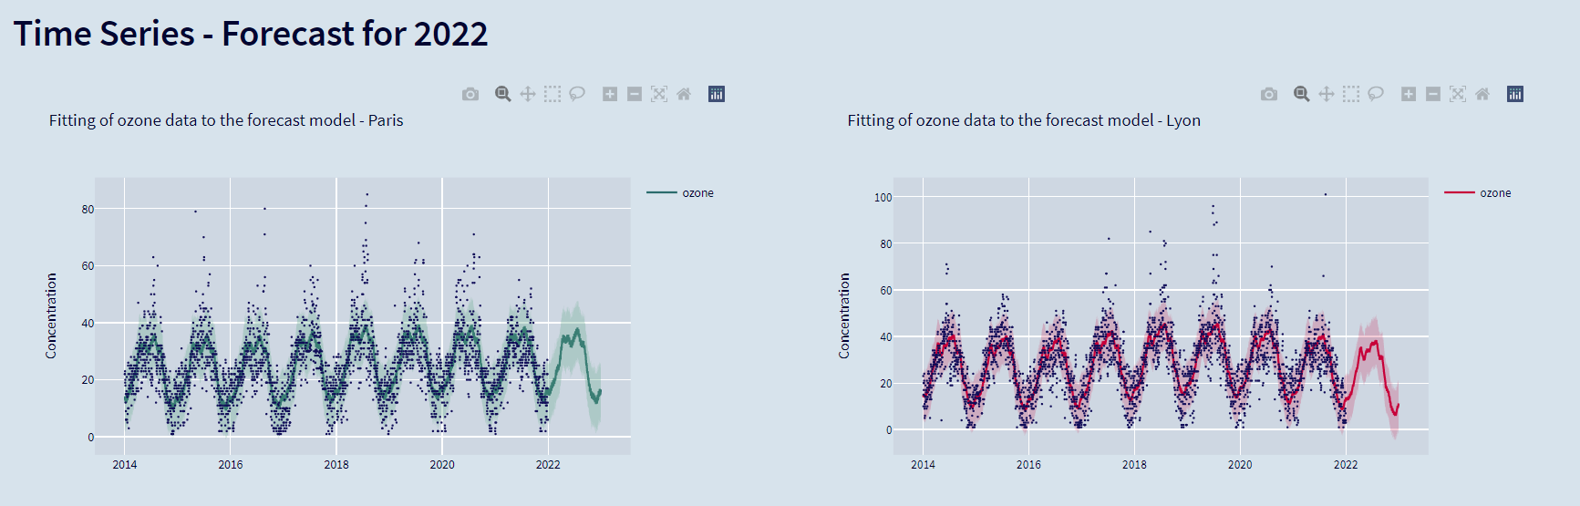
02
…
TIME SERIES
Forecast of Air Pollution for 2022
STREAMLIT: https://air-quality-final-project.herokuapp.com/

Slide 7

03
…
SUPERVISED ML
Air Quality from Weather
TARGET based on PM2.5 concentration:
PM2.5 µg/m³ | Class | Air Quality | PARIS | LYON
Below 50 | 0 | GOOD | 1876 | 1845
50-100 | 1 | MODERATE | 839 | 977
Above 100 | 2 | BAD | 207 | 100
LOGISTIC REGRESSION
RANDOM FOREST CLASSIFIER
BALANCED RANDOM FOREST CLASSIFIER STACKING ESTIMATOR (TPOT)

Slide 8

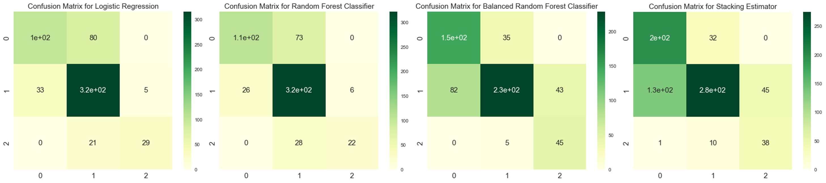
03
…
SUPERVISED ML
Air Quality from Weather
Model | Accuracy, % | Balanced Accuracy, % | f1_score, %
Logistic Regression | 76.2 | 67.7 | 75.3
Random Forest Classifier | 77.05 | 64.9 | 76.2
Balanced RF | 71.8 | 78.5 | 72.1
Stacking Estimator | 69.7 | 74.7 | 70.3

Slide 9
04
…
CONCLUSIONS
Practical use | Main Findings
PARIS
DATA recorded on 10.02.2022:
Pollutant | Models predictions | Real data
PM2.5 | 56 ± 22 | 63
PM10 | 29.5 ± 16 | 30
O₃ | 19 ± 10 | 16
NO₂ | 24.6 ± 12 | 28
MODERATE
STACKING ESTIMATOR: CLASS 1
LYON
Pollutant | Models predictions | Real data
PM2.5 | 47 ± 27 | 56
PM10 | 19 ± 11 | 23
O₃ | 16.6 ± 11 | 21
NO₂ | 12.7 ± 6 | 15
MODERATE
STACKING ESTIMATOR: CLASS 1

Slide 10
04
…
CONCLUSIONS
Practical use | Main Findings
Air quality is better in Lyon than in Paris
Trend in both cities is decreasing for all pollutants
All pollutants show yearly and weekly seasonality
Applied model correctly forecast pollution concentration
Supervised ML model correctly predicts air quality basing on the weather information in both Paris and Lyon
Created database and pipeline allows to perform the same analysis for other cities in Europe

Slide 11
Thank you for your attention!
Data Sources:
Air Pollution: https://aqicn.org/
Weather: https://www.visualcrossing.com/weather-api
Project links:
GitHub: https://github.com/radek-deb/Air_Quality_Paris-vs-Lyon_Final_Project
Dashboard: https://air-quality-final-project.herokuapp.com/
Trello: https://trello.com/b/vJ5wxT1K/finalprojectradek

